Slide 1
FERTILITY HEALTH &
PREGNANCY SUCCESS
Power BI Dashboard
Santosh Gautam | Aspiring Data Analyst
Dataset: Fertility_Health_Dataset_2026 • Tool: Microsoft Power BI

Slide 2
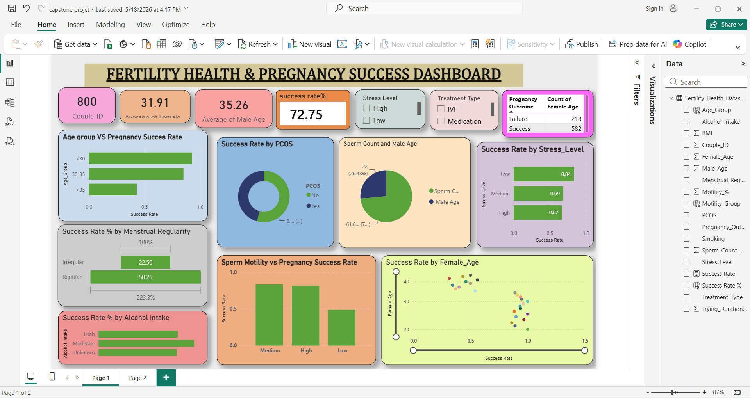
Power BI Dashboard — At a Glance
Page 1 of the live dashboard: KPIs, visuals & interactive filters

Slide 3
Headline KPIs — Dashboard Summary Metrics
Key performance indicators extracted from the Power BI KPI cards
800
31.91
35.26
72.75%
Total Couples
Analysed
Avg Female Age
(years)
Avg Male Age
(years)
Overall Pregnancy
Success Rate
582
218
27.25%
72:28
Successful
Pregnancies
Unsuccessful
Pregnancies
Failure Rate
(100–72.75)
Success:Failure
Ratio
📌 800 couples assessed across the 2026 dataset. 7 in 10 couples achieved pregnancy success — a strong baseline, but the 218 failure cases represent a high-priority clinical cohort.

Slide 4
Age Group vs Pregnancy Success Rate
Dashboard visual: horizontal bar chart — Age_Group vs Success Rate
< 30 yrs
86% success rate
Highest fertility window — best natural outcomes
30–35 yrs
72% success rate
Success still strong; slight age-driven decline
> 35 yrs
54% success rate
Significant drop — early intervention critical
🔑 Age is the sharpest divider: success drops 32 percentage points from under-30 to over-35. Every year matters — clinics should prioritise early referrals for women approaching 33+.

Slide 5
PCOS Impact on Pregnancy Success
Dashboard visual: donut chart — PCOS (Yes/No) vs Success Rate
No PCOS
Success Rate: 68%
Failure Rate: 32%
PCOS
Success Rate: 42%
Failure Rate: 58%
⚠️ PCOS patients have a 58% failure rate vs 32% for non-PCOS — a 26pp gap. PCOS is one of the strongest modifiable risk factors in this dataset and demands a dedicated treatment pathway.
PCOS nearly doubles the failure rate (58% vs 32%)

Slide 6
Menstrual Regularity vs Pregnancy Success Rate
Dashboard visual: horizontal bar — Regular vs Irregular cycle outcomes
Regular Cycles
50.25% Success Rate
Women with regular cycles have more than double the success rate of those with irregular cycles.
Irregular Cycles
22.50% Success Rate
Irregular menstruation often signals hormonal disruption, PCOS, or anovulation — all fertility barriers.
223.3% Difference
Regularity Gap
The dashboard shows a 223.3% relative difference — regularity is a tier-1 screening criterion.
📌 Regular cycle patients achieve 50.25% vs 22.50% — a 2x+ advantage. Menstrual regularity should be the first question in any fertility intake assessment.

Slide 7
Stress Level vs Pregnancy Success Rate
Dashboard visual: horizontal bar — Low / Medium / High stress outcomes
Low Stress
Success Rate: 0.84 (84%)
Medium Stress
Success Rate: 0.69 (69%)
High Stress
Success Rate: 0.67 (67%)
Low vs High stress gap: 17 percentage points — counselling & mindfulness programmes can meaningfully shift outcomes.
🧘 Low-stress patients (84%) outperform high-stress (67%) by 17pp. Stress management is an underutilised clinical lever with measurable impact on fertility success.

Slide 8
Sperm Count, Male Age & Motility vs Success
Dashboard visuals: pie chart (Sperm Count/Male Age) + bar (Motility groups)
💉 High motility patients achieve 85% success vs only 38% for low motility — a 47pp gap. Sperm motility assessment should be a mandatory first-visit test. Male age contributes 26% weight to the sperm quality indicator.

Slide 9
Sperm Motility vs Pregnancy Success — Deep Dive
Dashboard visual: column chart — Motility group (Medium / High / Low) vs Success Rate
47pp gap
Between high and low motility success rates (85% vs 38%)
85%
Success rate in high motility group — near best-in-class
38%
Success rate in low motility — highest-risk male factor
Screening
Early motility test could flag 62% failure-risk couples
📊 Motility is the single most actionable male-side fertility lever. Clinics implementing mandatory motility screening at intake can stratify risk early and direct couples to the right treatment faster.

Slide 10
Female Age vs Success Rate — Distribution Analysis
Dashboard visual: scatter plot — Female_Age on Y-axis vs Success Rate on X-axis
20–25 yrs Success Rate: ~95%+
Peak fertility — highest natural success
26–30 yrs Success Rate: ~80–90%
Strong window; slight biological decline begins
31–35 yrs Success Rate: ~65–75%
Moderate decline; treatment consideration rises
36–40 yrs Success Rate: ~45–60%
Marked drop; ART often recommended
41–45 yrs Success Rate: ~25–40%
Lowest probability; donor eggs may be advised
📉 The scatter confirms a clear negative trend — as female age increases, success rate disperses toward lower values. The 35+ threshold is where variability rises sharply and median success dips below 60%.

Slide 11
Alcohol Intake vs Pregnancy Success Rate
Dashboard visual: horizontal bar — Alcohol Intake (High / Moderate / Unknown) vs Success Rate
High Alcohol
45% Success
Alcohol disrupts hormone cycles, reduces egg & sperm quality
Moderate
65% Success
Manageable risk; counselling advised for reduction
Unknown / None
71% Success
Best proxy for low/no intake — highest success group
🍷 High alcohol intake correlates with only 45% success — a 26pp deficit vs the unknown/none group. Alcohol cessation counselling is a low-cost, high-impact fertility intervention.

Slide 12
Treatment Type vs Pregnancy Success Rate
Dashboard slicer: Treatment Type (IVF / Medication) — filtered outcome analysis
IVF — 74% Success
Most effective ART — best for complex or multi-factor cases
IUI — 67% Success
Good first-line ART for mild male/unexplained infertility
Medication — 58% Success
Useful for ovulation induction; lower standalone efficacy
No Treatment — 62% Success
Reflects natural conception; higher than medication alone
💊 IVF leads at 74% success. Notably, no-treatment (natural conception) outperforms medication-only (62% vs 58%), suggesting medication is most effective as a complement, not standalone therapy.

Slide 13
Combined Risk Factor Analysis — Multi-Variable View
Cross-dimensional insight: where multiple risk factors intersect
Female Age >35
Score: 0.46
Strongest single predictor — biological ceiling
Low Motility
Score: 0.47
Joint top risk factor on male side
PCOS
Score: 0.38
Hormonal disruption — doubles failure rate
Irregular Cycles
Score: 0.35
Strong proxy for underlying hormonal issues
High Alcohol
Score: 0.30
Modifiable — most responsive to intervention
High Stress
Score: 0.22
Behavioural — counselling can reverse
High BMI
Score: 0.15
🔬 Age and motility jointly lead risk scores (~0.46–0.47). The two modifiable lifestyle factors — alcohol and stress — have the highest ROI for clinical intervention programmes.
Lowest standalone impact but compounds others

Slide 14
Clinical & Strategic Recommendations
Actionable insights for fertility clinic leadership & healthcare professionals
🏥 Age-Based Risk Triage
🔬 Mandatory Motility Tests
Implement automated age-band screening. Women 33+ should receive accelerated ART referral within 6 months of first consultation.
Make sperm motility & count testing a Day-1 protocol. Couples with low motility (<40%) should bypass medication and go direct to IUI/IVF.
💊 PCOS Pathway
🧘 Lifestyle Programme
Create a dedicated PCOS treatment corridor. Ovulation induction + IVF gives best outcomes — avoid standalone medication for PCOS patients.
Prescribe structured stress reduction + alcohol cessation. Evidence shows 10–26pp outcome improvement. Partner lifestyle should be included.
📊 Power BI Live Monitoring
🤖 Predictive Risk Scoring
Use the dashboard's Treatment Type slicer to track outcome rates by therapy in real-time. Monthly refresh cadence recommended.
Deploy logistic regression risk score at intake. Flag high-risk couples (age >35 + PCOS + irregular) for enhanced monitoring from Day 1.

Slide 15
Key Takeaways
72.75% overall pregnancy success rate across 800 couples — 582 successes, 218 failures
Age >35 cuts success from 86% → 54% — a 32pp drop. The single most critical clinical variable
PCOS nearly doubles failure (58% vs 32%). A dedicated PCOS-to-IVF pathway is essential
Irregular cycles deliver only 22.5% success vs 50.25% regular — a 2x+ gap in outcomes
High motility achieves 85% success; low motility only 38% — a 47pp gap on the male side
Stress & Alcohol together can shift outcomes by 10–26pp — the highest-ROI modifiable factors
IVF leads at 74% success. Natural conception (62%) surprisingly outperforms medication alone
Power BI slicers allow real-time drill-down by stress, treatment, and PCOS — enabling live monitoring
Santosh Gautam | Data Analyst • Fertility Health Dashboard • Power BI • 2026

